Slide 1


Department of Artificial Intelligence and Data Science
Book Recommendation System
Prasanna K (221801037)
Prasanna S (221801038)
Rohith RA (221801041)

Slide 2
Introduction:
The book recommendation software is designed to deliver personalized reading experiences, featuring user-friendly options on the homepage.
Users are guided through a structured selection process, starting with setting their reading preferences, such as time to read constraints and preferred narrative types. The software then provides a dynamic interface for selecting specific genres or themes.
For each chosen preference, the application presents a curated list of recommended books, allowing users to create customized reading lists from an extensive library. The system automatically sorts books by relevance and provides detailed summaries and ratings to enhance the user experience.

Slide 3
Existing Systems:
Collaborative Filtering:
-Suggests books based on what similar users have enjoyed
Content-Based Filtering:
-Recommends books that are similar to those a user has liked before
Hybrid Systems:
-Combines collaborative and content-based methods for better recommendations.

Slide 4
Advantages and Disadvantages of Existing System:
Advantages of Existing System:
Users are familiar with the interface and operation of the system.
The system has an existing user base, leading to more data for personalized recommendations.
The system suggests books or items based on user preferences, improving engagement.
Disadvantages of Existing System:
Hybrid systems are harder to implement and require more computational resources.
All systems require large and detailed datasets for effective performance. Sparse or incomplete data can lead to inaccurate recommendations.

Slide 5
Proposed System:
The proposed book recommendation software aims to address the limitations of existing book recommendation systems.
Narrative Style Matching:
Matches users with books based on their preferred narrative style, such as character-driven vs. plot-driven, for a more personalized reading experience.
Time Commitment Suggestions:
Offers book recommendations based on the time users have available to read, suggesting books categorized as Short, Medium, or Long, depending on the time the user can commit to reading.
Genre-Based Recommendations:
Recommends books within the user’s preferred genre, such as Sci-Fi or Romance etc..

Slide 6
Advantages and Disadvantages of Proposed System:
Advantages of Proposed System:
Time-Saving: Helps users choose books based on available reading time.
Better User Experience: Offers more relevant book choices, increasing user satisfaction.
Cater to Various Readers: Suitable for users with different reading habits and time constraints.
Personalized Suggestions: Tailors book recommendations based on user preferences.
Disadvantages of Proposed System:
Limited to Available Data: Suggestions can only be as good as the data available on books and user preferences.
Limited Variety: Over-relying on genres or time commitment might restrict diversity in book recommendations.
Requires Active Input: Users must input their preferences regularly for the system to remain effective, which could be a hassle for some.

Slide 7
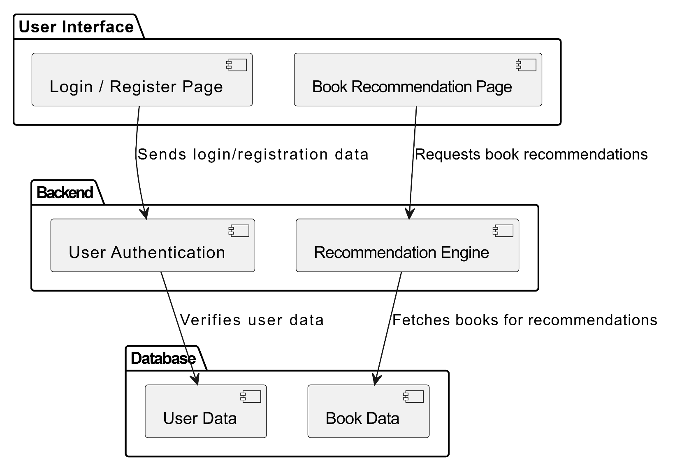
Architecture:

Slide 8
Modules :
1. User Management Module:
Login/Registration: Handles user authentication, enabling users to log in, register, and manage their credentials.
Profile Management: Allows users to view and update personal details such as their name and preferences.
Session Management: Manages user sessions, ensuring users stay logged in during interactions with the app.
2. Book Recommendation Module:
Book Catalog: Displays a list of available books along with their details, such as title, genre, and length.
Search & Filter: Provides users with the ability to search for books based on specific criteria like genre and narrative style.
Book Recommendation Engine: Recommends books based on user preferences, such as genre, narrative, and preferred reading time.

Slide 9
Modules :
3. Admin Management Module:
User Management: Allows the admin to manage users, including registration, login status, and other user details.
Book Management: Admin can add, update, or remove books from the catalog, keeping the recommendations fresh.
Reporting: Provides insights into user activity, book recommendations, and other statistics for monitoring system performance.

Slide 10
Unit Testing :
Unit testing is the process where you test the smallest functional unit of code. Software testing helps ensure code quality, and it's an integral part of software development. It's a software development best practice to write software as small, functional units then write a unit test for each code unit.

Slide 11
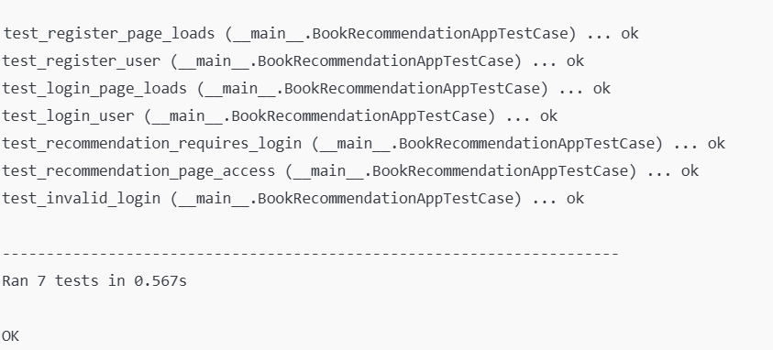
Unit Testing:

Slide 12
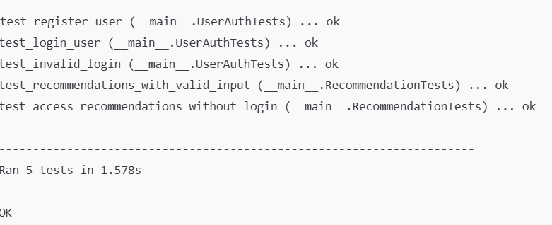
Unit Testing:

Slide 13
Integration Testing :
Integration testing is a type of software testing that verifies that the components of an application work together as expected. It's a broader test than unit testing, which focuses on isolated components of an application.

Slide 14
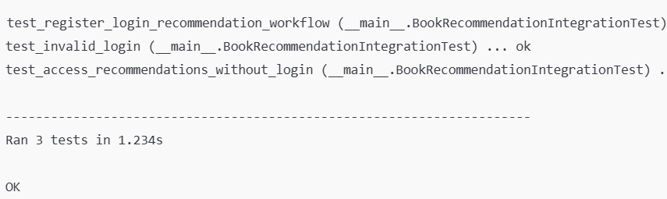
Integration Testing:

Slide 15
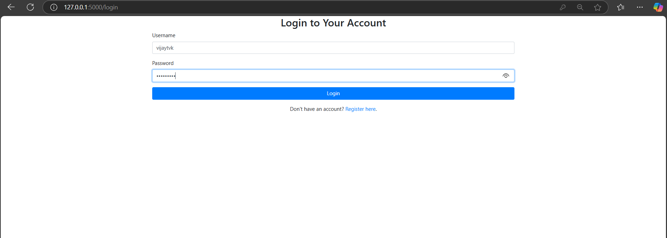
Login Page:

Slide 16
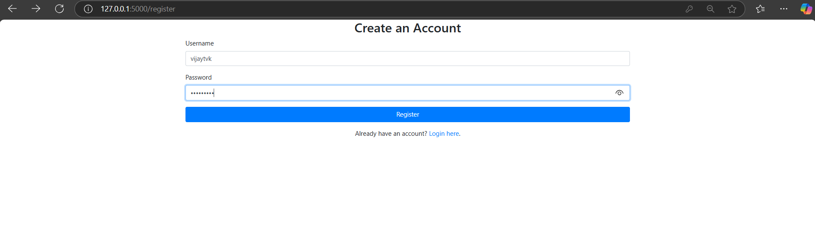
Register Form:

Slide 17
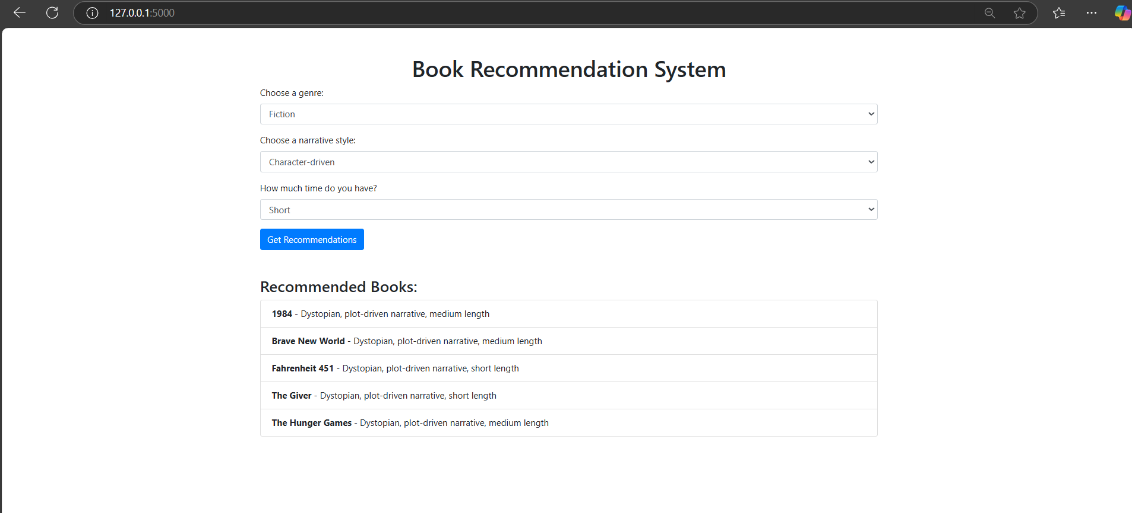
Output:

Slide 18
Data Flow Diagram :
Level 0 DFD:
Register/Login
Filtering
USER
Recommendation Engine
ADMIN
Search Books
Level 1 DFD:
User
Recommendation
system
Login/Registration
View Library
Hybrid Filtering
User Database
Books Database
Catergories

Slide 19
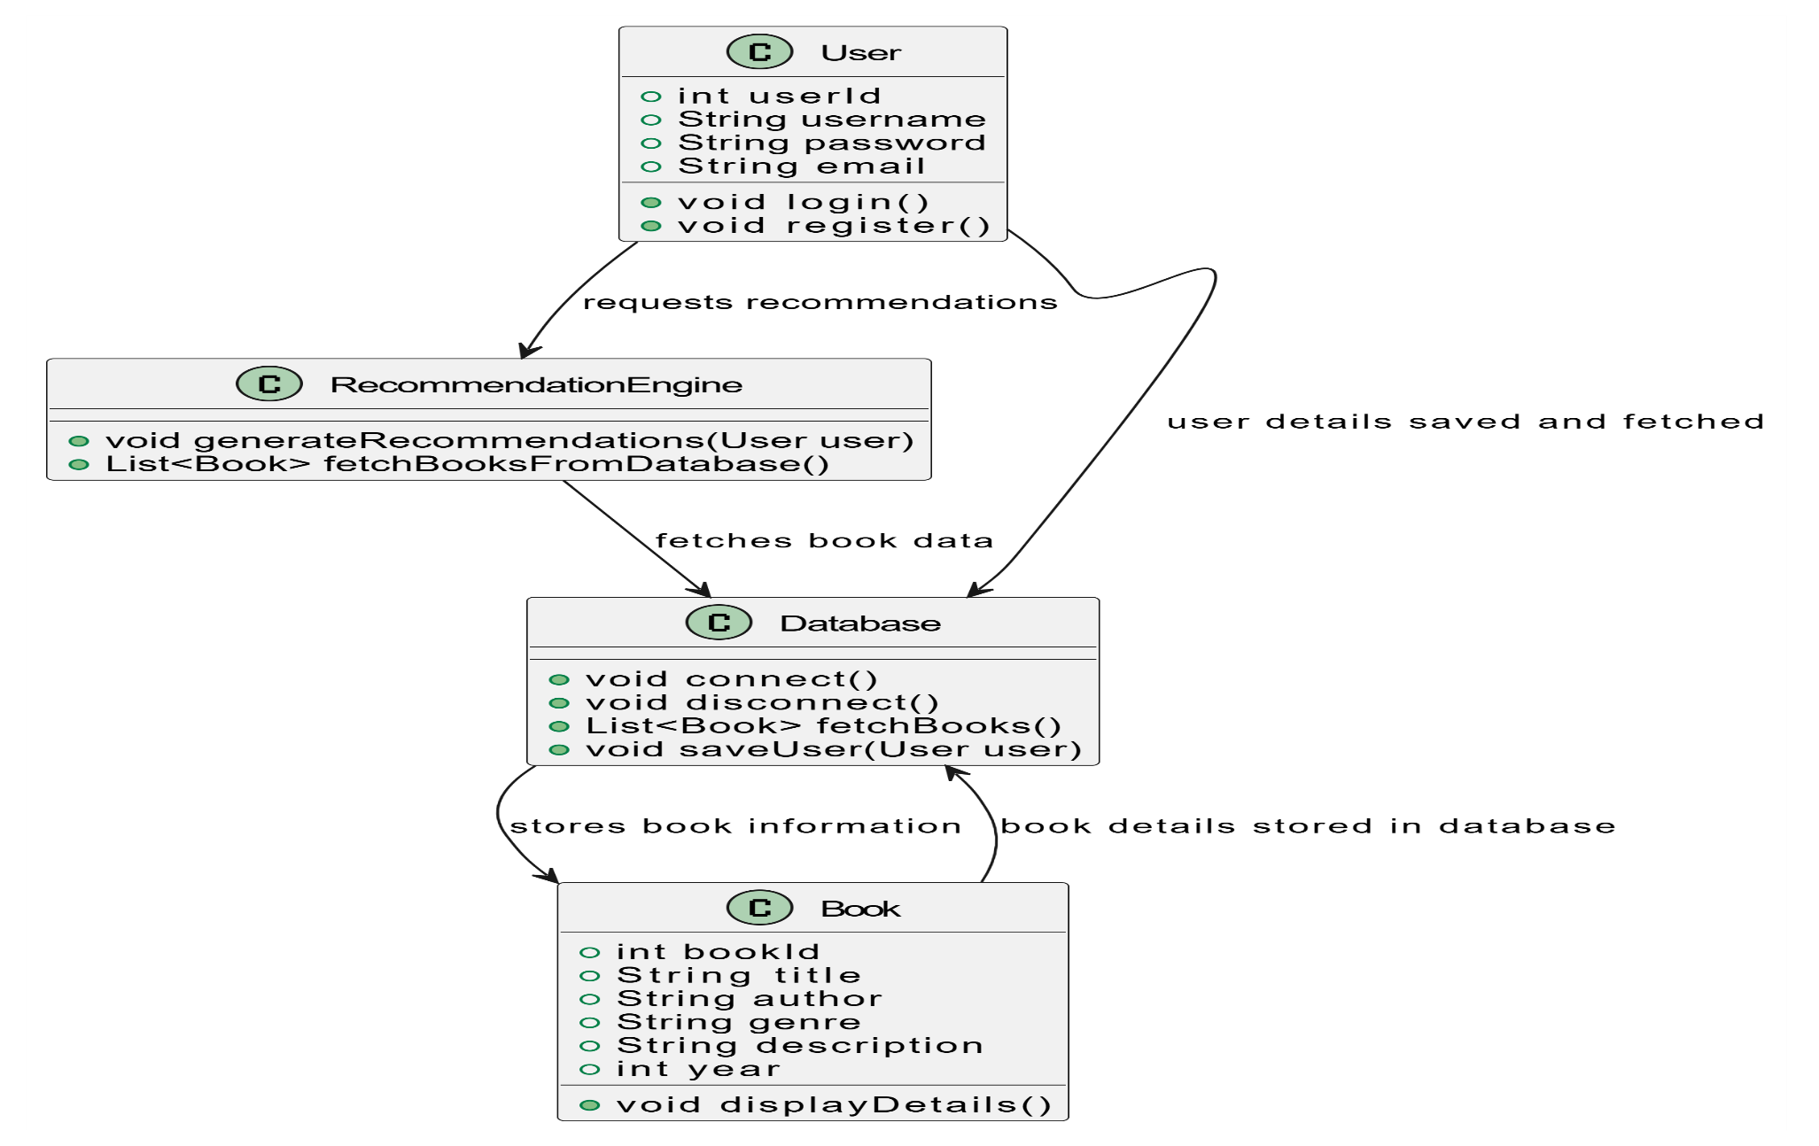
Object Oriented Design:

Slide 20
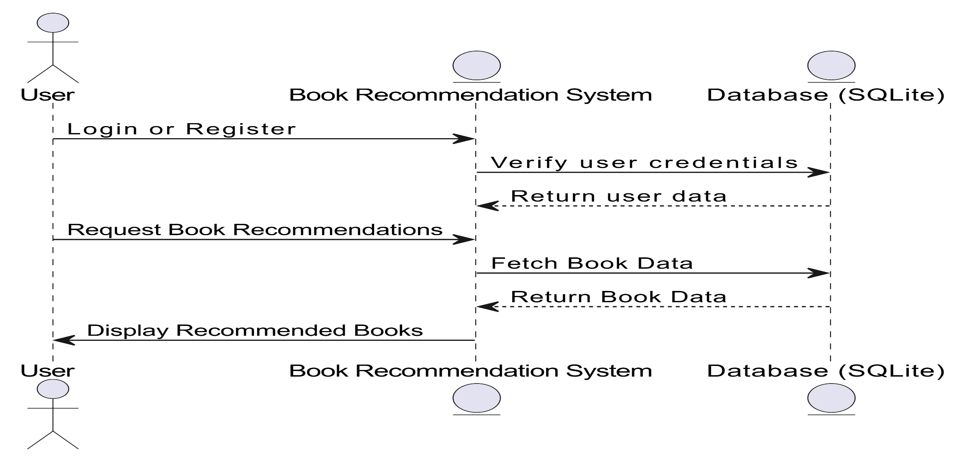
Sequence Diagram :

Slide 21
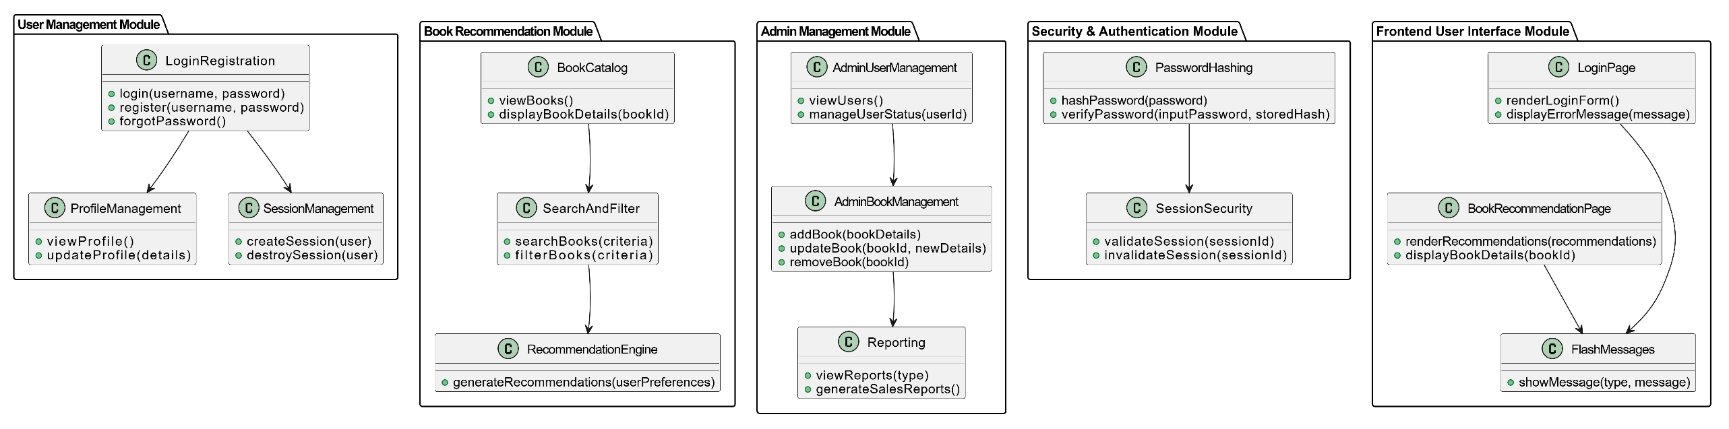
Class Diagram :

Slide 22
Conclusion :
In conclusion, the book recommendation software offers a tailored reading experience by considering individual preferences such as time constraints and narrative styles. With its user-friendly interface, the system helps users discover books that align with their interests, providing curated recommendations from a vast library. By allowing users to create personalized reading lists and offering detailed summaries and ratings, the software enhances the book selection process, making it easier and more enjoyable for readers to find their next great read. This project aims to improve user satisfaction and engagement in discovering books based on their unique preferences.

Slide 23
References :
Flask Official Documentation: https://flask.palletsprojects.com/
Werkzeug Documentation: https://werkzeug.palletsprojects.com/
Jinja2 Documentation: https://jinja.palletsprojects.com/
SQLite Documentation: https://www.sqlite.org/docs.html
"Flask Web Development" by Miguel Grinberg: https://www.amazon.com/Flask-Web-Development-Development-Deployments/dp/1449372627
"Python and Flask Bootcamp: Create Websites with Flask!" by Jose Portilla (Udemy): https://www.udemy.com/course/python-and-flask-bootcamp-create-websites-with-flask/
"Python Data Science Handbook" by Jake VanderPlas: https://www.oreilly.com/library/view/python-data-science/9781491912126/

Slide 24
Thank You

